Slide 1
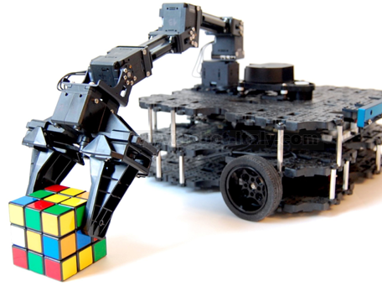
Mobile Autonomous Robot for Indoor and Outdoor Collection Of Medical Waste (MARIO-COM)

Slide 2
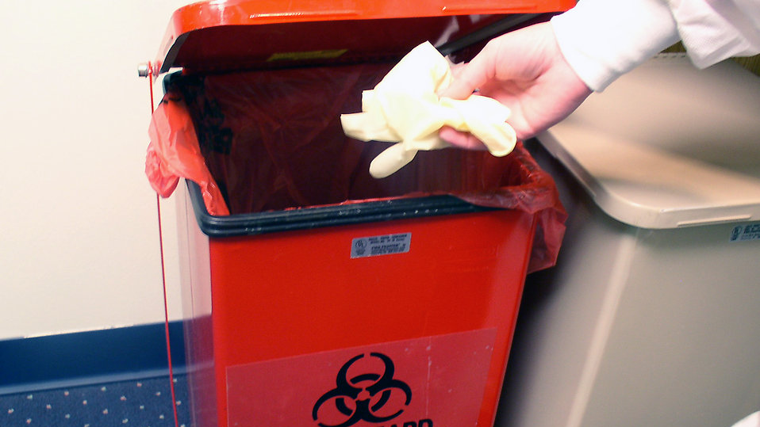
Motivation
Hospital waste transport and handling is a time-consuming, hazardous and infectious process as the staff is exposed to be in contact with medical and bio-hazardous substances. The biomedical waste collected from the hospital should not be stored in bins for more than 24 hours and has to be disposed of immediately. In order to avoid stagnation, we need to ensure regular and safe disposal of waste to help the hospital maintain a clean environment for the patients, staff, and visitors.
BUT.. how do we solve this efficiently by minimizing the risk, we thought for a while and were out of ideas
THEN.. We closed our laptops and watched Wall-E, that is when an epiphany hit me,
WHY.. Shouldn't we just make something like Wall-E with whatever we have at our hand.
SO.. We discussed and ended up with our project idea MARIO-COM

Slide 3

Objective
The objective of this project is to design and deploy a mobile robot-based medical waste collection and disposal solution to efficiently and safely transport medical waste trash bins from different locations inside a hospital to the disposal zone.
This Photo by Unknown author is licensed under CC BY-NC-ND.

Slide 4
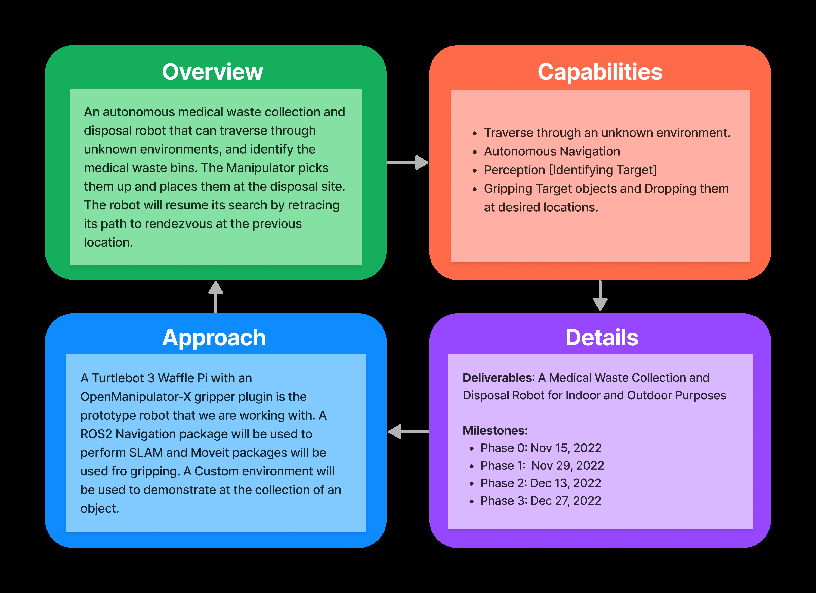
Quad Chart

Slide 5

Robot Architecture
ROBOTIS Turtlebot
Open Manipulator X Gripper
Camera Sensor
LIDAR Sensor

Slide 6

Software Architecture & Development
Perception
Navigation
Manipulation
AIP
Programming
Testing
Version Control

Slide 7
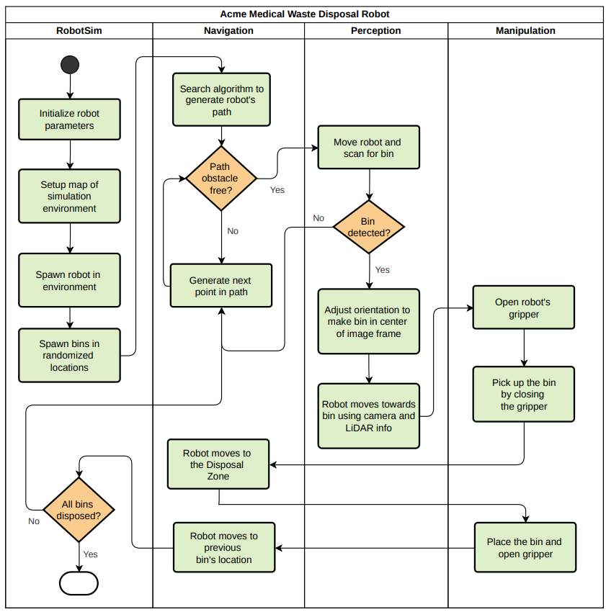
Activity Diagram
Activity Diagram Link

Slide 8
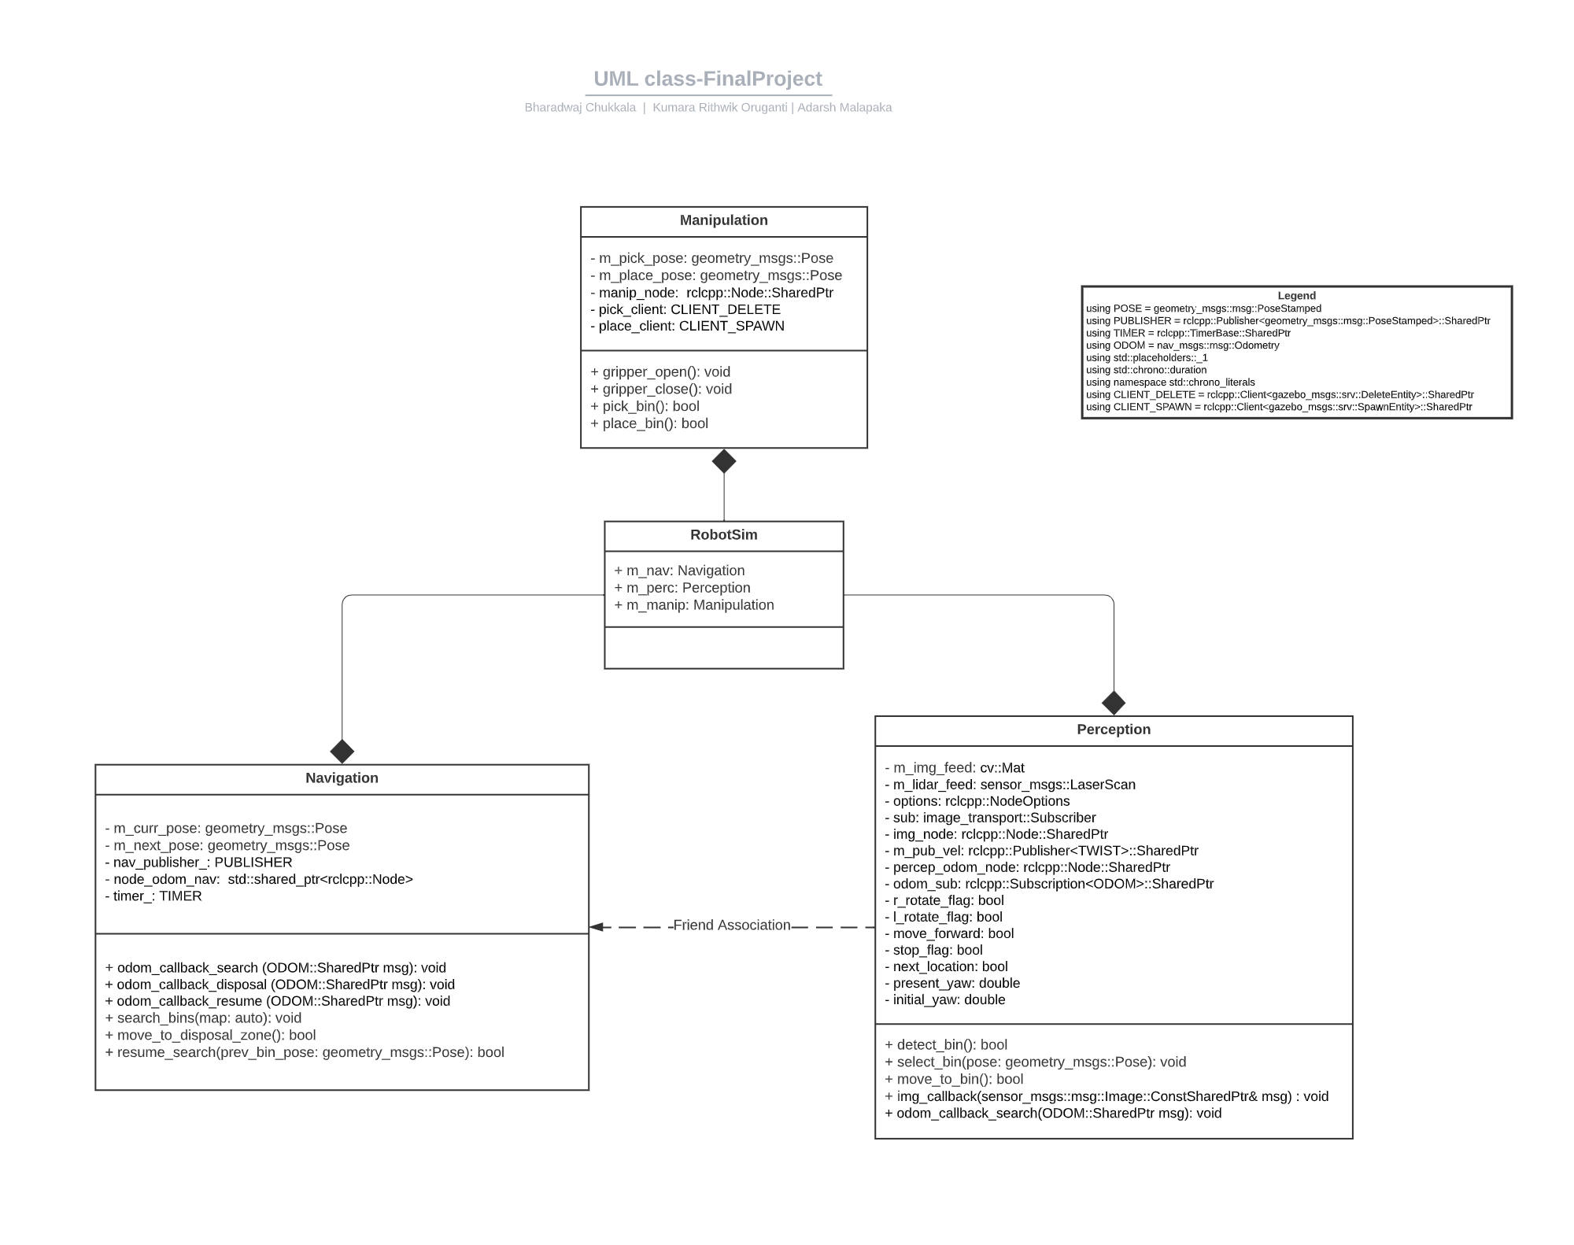
UML Diagram
UML Diagram Link

Slide 9

Tools and Dependencies
Linux Environment
Robot Operating System (ROS2 Foxy)
OpenCV
OpenManipulator-X Gripper
Turtlebot3 Waffle-Pi
CodeCov
Valgrind
C++
Nav2 ROS Stack
Gazebo
Git and Github for CI/CD
Doxygen

Slide 10

Bugs and Fixes
The OpenManipulator-X with TurtleBot3 is yet to update their page for ROS2 MoveIt functionality.
The assumption is that the bins spawned in the environment will be deleted and respawned at the disposal location which is the expected behavior of the robot.
Minimal support for errors and continuous integration is available from the community for specific questions in ROS2.
SDF file reading using C++ and parsing to Gazebo's /spawn_entity action doesn't exist. Work arounds can be using the ROS Parameter Server or C++ System Command.
Cartographer map generation doesn't work for big size maps that has a lot of open space.
This Photo by Unknown Author is licensed under CC BY-NC-ND

Slide 11

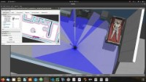
Live Demo

Slide 12

Thank You

